Slide 1
Dr. Mohan Venkataramana (President)
Dr. Jur. Marc Mathys (CEO)
Pain Stoppers
Augmented Pain Therapy with AI and Yoga
Info @ painstoppers.ml (626) 399-1843

Slide 2


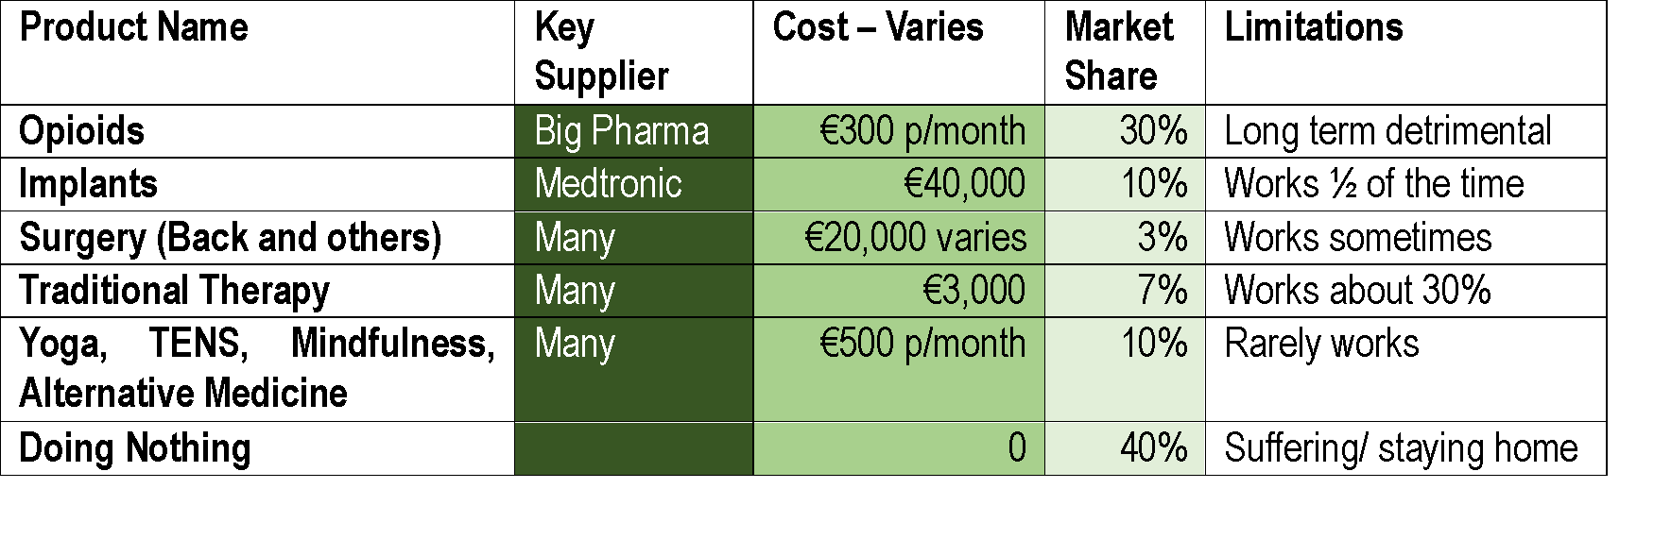
Email: Info @ painstoppers.ml Phone: (626) 399-1843
Pain Stoppers
PROBLEM AND MARKET OPPORTUNITY
Chronic pain is pain that lasts longer than 3 months.
Episodic or continuous, inconvenient or totally incapacitating.
30% of paraplegics have chronic pain
Chronic pain affects 1 in 5 adults in Europe. US CDC estimates (in 2016) that 20.4% of U.S. adults (50 million) had chronic pain and 8.0% of U.S. adults (19.6 million) had high-impact chronic pain.
Current solutions: CBT, opiates, neurostimulation, and surgery
Total cost is over €400 billion in Europe and $635 billion a year in USA, which is more than the yearly costs for cancer, heart disease and diabetes.
CNS Therapy, AG

Slide 3


Email: Info @ painstoppers.ml Phone: (626) 399-1843
Pain Stoppers
OUR OBJECTIVE
HELPING PATIENTS LIVE PAIN-FREE LIVES
We are pioneers in neuromodulation, combining systolic and diastolic timed electrical peripheral stimulation and operant behavioral therapy for chronic pain.
Patented neuromodulation
technology
Non-invasive and low risk medical device
Validated through an RCT study. 82% of female FM became Pain Free at the 12-month follow-up.
Operant behavioral therapy guided by a therapist and patient E-learning program

Slide 4



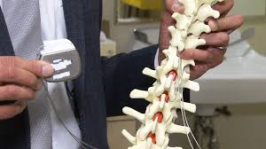

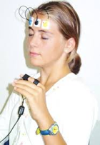
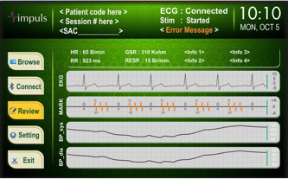
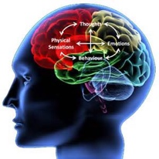
Email: Info @ painstoppers.ml Phone: (626) 399-1843
Pain Stoppers
EXISTING SOLUTIONS AND OUR SOLUTION (SET)
EXISTING SOLUTIONS / ISSUES
SET – Systolic Extinction Training
Medication: Long-term opioid use increases pain
The SET device stimulates the patient through the finger
Implants: Expensive and often ineffective
Improves known pain biomarkers
Collects patient biometric data
Multimodal Therapy: Just reduces pain
The device calculates baroreceptor sensitivity (BRS) during every Yoga session
Traditional Therapy: Ignores patient heterogeneity
SET has a long-term effect (6-12 months) and can be refreshed if needed
Bio Neurofeedback: Same as CBT, but less effective

Slide 5
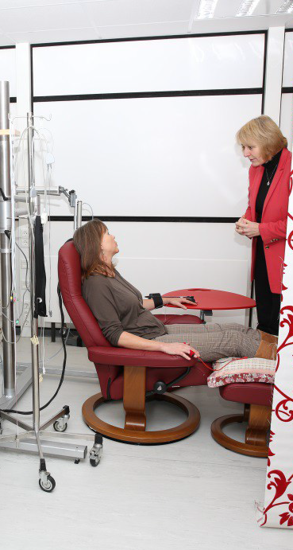
Email: Info @ painstoppers.ml Phone: (626) 399-1843
Pain Stoppers
OUR SOLUTION - SET
SET – Systolic Extinction Training
A novel non-invasive and low risk medical device
Cardiac gated electrical stimulation to the hand
disrupts pain patterns and encourages learning.
combined with
Behavioral Operant Therapy, AI and Yoga
Change patient and partner pain adaptations,
behaviors, cognitions, rewards, and movement.
5 weeks, 20 hours, highly successful
Medical Device Retail pricing $20,000 - TBD
Reimbursement - TBD

Slide 6

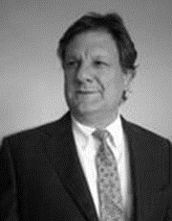


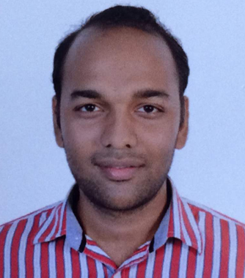
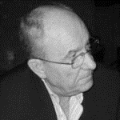
Email: Info @ painstoppers.ml Phone: (626) 399-1843
Pain Stoppers
MANAGEMENT & RESEARCH TEAM
Dr. Mohan Venkataramana - President, - has a B.Tech from Indian Institute of Technology and Ph.D from Massachusetts Institute of technology in Chemical Engineering. Mohan is a serial entrepreneur and has been involved as an owner founder of several medical and technology companies as well as non-profit initiatives.
Dr. Jur. Marc Mathys – CEO, lawyer, engineer and manager (Harvard BS) medical and technology companies and Mr. Mathys is a member of Start-up Health, the largest and most important digital health incubators and is a published chronic pain expert.
Prof. Kati Thieme, PhD, CTO Inventor of SET, 30 years clinical experience in chronic pain, at expert biometric makers, peripheral neuro stimulation, and behavioral therapy with pain, migraine, rheumatoid arthritis, lupus, fibromyalgia. Head of the Institute of Medical Psychology at the University of Marburg. Her honors include the German Pain Prize.
Prof. Pitchumani Angayarkanni, PhD, Accomplished researcher in computer science, specializing in artificial intelligence and machine language. She has over 15 years of teaching and research experience, with several publications and collaborations.
Dr. Sriloy Mohanty, currently a Research Associate at Center for Integrative Medicine and Research, All India Institute of Medical Sciences (AIIMS) New Delhi. His doctoral work is on Yoga based Cardiac Rehabilitation for patients undergoing percutaneous coronary interventions. He has been originally contributing in the field of Integrative Medicine, Yoga therapy and Naturopathy. He has authored 22 publications. His research interest includes Integrative medicine research, Public Health and Psychosomatic Medicine.
Dieter Klein, MBA, - has an MBA from the University of St. Gallen, Switzerland, is a serial entrepreneur and has been involved as an owner founder of several medical and technology companies.
Dr. Gerhard Scheuch Gerhard is a Bio Physicist for Pulmonary Drug Delivery. Regulatory Expert at EMA and serving on different scientific advisory boards of big Pharma Companies. Founder and CEO of Activaero, Founder of Inamed which is a CRO specialized in the field of respiratory diseases and Ventaleon which is a project company using inhaled LASAG to treat different respiratory viral infections.

Slide 7
Email: Info @ painstoppers.ml Phone: (626) 399-1843
Pain Stoppers
LEAN CANVAS (BUSINESS MODEL)

Slide 8

Email: Info @ painstoppers.ml Phone: (626) 399-1843
Pain Stoppers
THERAPY AI MARKET)
Welldoc - Expands Chronic Condition Platform to Include Behavioral Health. Total Funding $55.2M
Solera - Happy and Healthy Employees - manage a health vertical and not one vendor per class. Total Funding $72.3M
Omada Health - Virtual Care, Diabetes, Musculoskeletal, Hypertension, Behavioral Health. Total Funding $256.5M
Biofourmis - AI for chronic care. FDA cleared. Wearable biosensor with data from millions of patients. Designed to predict and prevent deterioration before it happens. Total Funding $143.6M
Livongo - Diabetes you receive monitoring devices, unlimited strips and lancets, personalized insights, health coaches you can trust Total Funding $235M
My Online Therapy* – UK - Answer questions get connected to the right psychologist - and choose how you get therapy. Total Funding £4.5M
Pear – Digital Therapeutics for the treatment of serious disease.
Total Funding $332.2M
A
N
D
M
O
R
E
B2B
*B2C
Answer a few questions and get connected to the right psychologist straight away - and choose how you get therapy (by video, live chat or daily coaching).

Slide 9









Email: Info @ painstoppers.ml Phone: (626) 399-1843
Pain Stoppers
TRACTION
Germany: Partners for phase II testing and probable future customers include: The German Pain Society (32 clinics) and 5 Universities: Berlin (Anesthesiology), Munich (Neurology), Bochum, and Marburg (Medical and Psychology).
Spain, a senior executive is waiting to sponsor SET (Prof. Thieme made his wife pain-free and the couple had a child - impossible before treatment). Universitat de Barcelona, Hospital Sant Joan de Déu Barcelona, Hospital Universitario Virgen del Rocio.
France: Special Fibromyalgia Regulation
For the rest of the EU, we need to identify early adopters and opinion leaders.
32 x
4 x

Slide 10
Pain Stoppers
THERAPY AI MARKET)
Email: Info @ painstoppers.ml
Phone: (626) 399-1843
Peripheral Neuromodulation
Non-invasive Individualized Pain Freedom
Behavioral Therapy
THANK
YOU
Confidential

